Slide 1
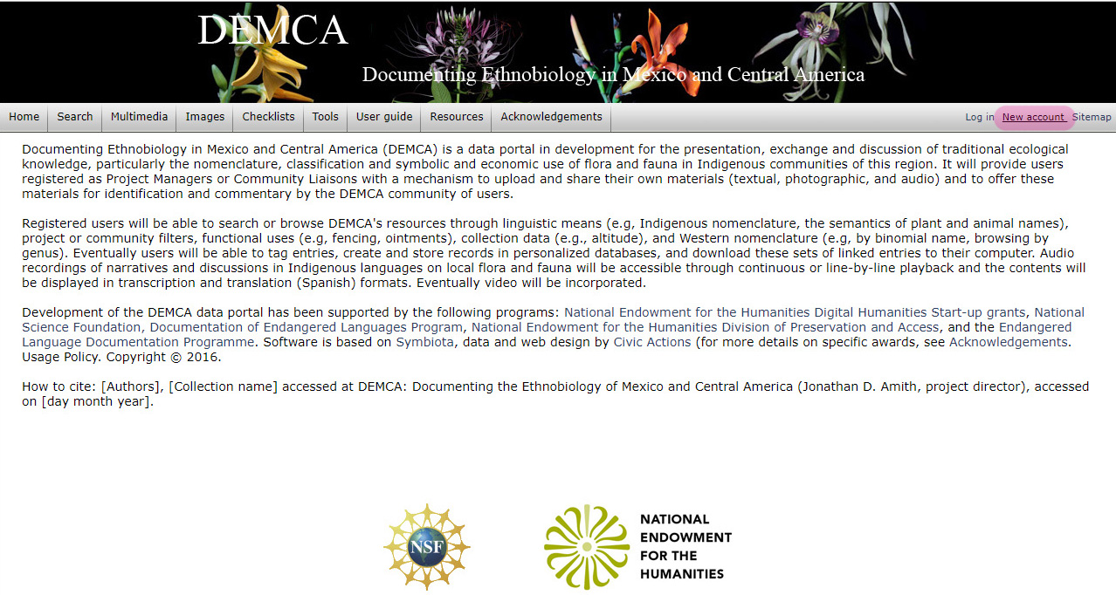
DEMCA: Creating a project
Setting up an account
Click on “New account” to set up an account. Account holders may:
Request permission to manage a project
By default be able to comment on (“annotate”) information on other projects such as vernacular names
Notes:
Have attendees create an account.
Account holders will be able to annotate entries or create their own projects. Note that unlike inaturalist and other citizen sciencce online systems, DEMCA is project oriented. To create an authorized account an individual or group will need to create a strategy for documentation. It can be simplel: Hymenoptera among the Mixe. Or complex in the case of a florist and ethnobotanical study.
Three basic types of project
Collection: Physical specimens or recorded (photographed) observations.
Resources: Published and unpublished (ms) resources, herbarium and museum labels, etc.
Elicitation: Work with one or more speakers, including cases in which the project manager “eliciits” his or her own list of biotaxa
Registered users are also able to annotate any entry in a wiki-type way, e.g,. Correcting a vernacular name or translation, commenting on cognates, loans, calques.

Slide 2
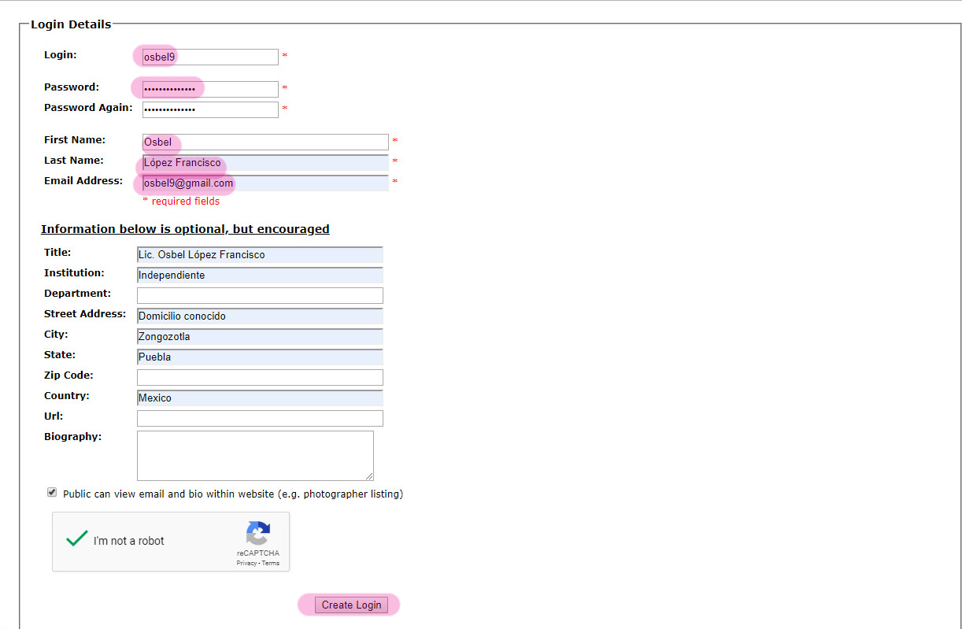
DEMCA: Creating a project
Setting up an account
Not all fields are required but those that are required must be filled in.
Notes:
This is a very simple form to create an account.

Slide 3
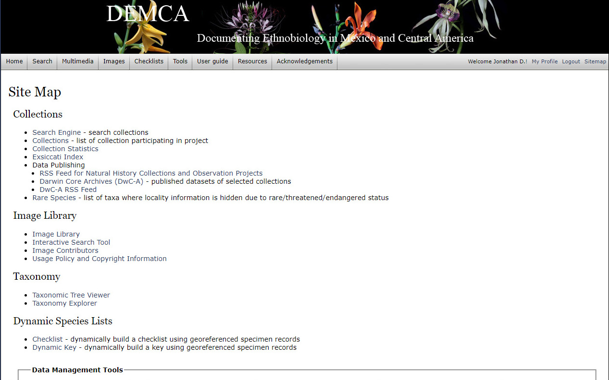
DEMCA: Creating a project
Upon request super administrator sets up a project and assigns permissions
Super administrator goes to site map and then to Data Management Tools
Notes:
The superadministrator(s) can then log on and set up permissions, but only to registered users. The project manager/administrator lets the Super administrator know who should have what privileges. This slide is the top of the “site map” page as the Superadministrator sees it. The next slide is the bottom.

Slide 4
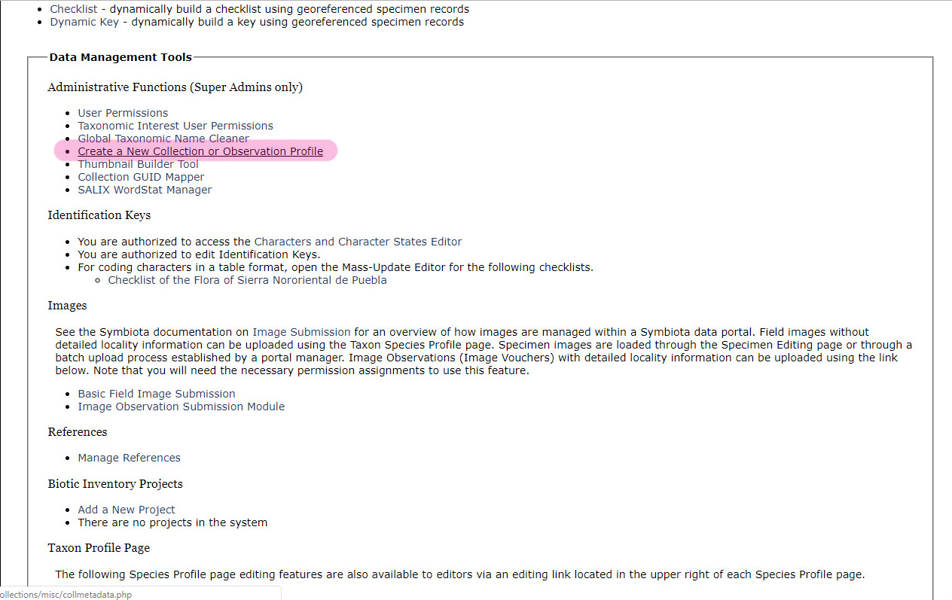
DEMCA: Creating a project
Upon request super administrator sets up a project and assigns permissions
Super administrator then can select the appropriate line to Create a New Collection or Observation Profile
Notes:
Here in Administrative Functions the superadministrator, and only the superadministrator, can create a New Collection or Observation Profile.
Note that in the near future there will be 3 types of data resources:
1. Collections and observations (physical specimens or still photos, DwC metadata)
2. Resources: Published and unpublished, museum and herbaria.
3. Elicitation: Either one person or several who discuss plant names, descriptions, and uses. Note that it is important that some scientific name be associated to all data. Probably one of the higher-level orders will work.

Slide 5
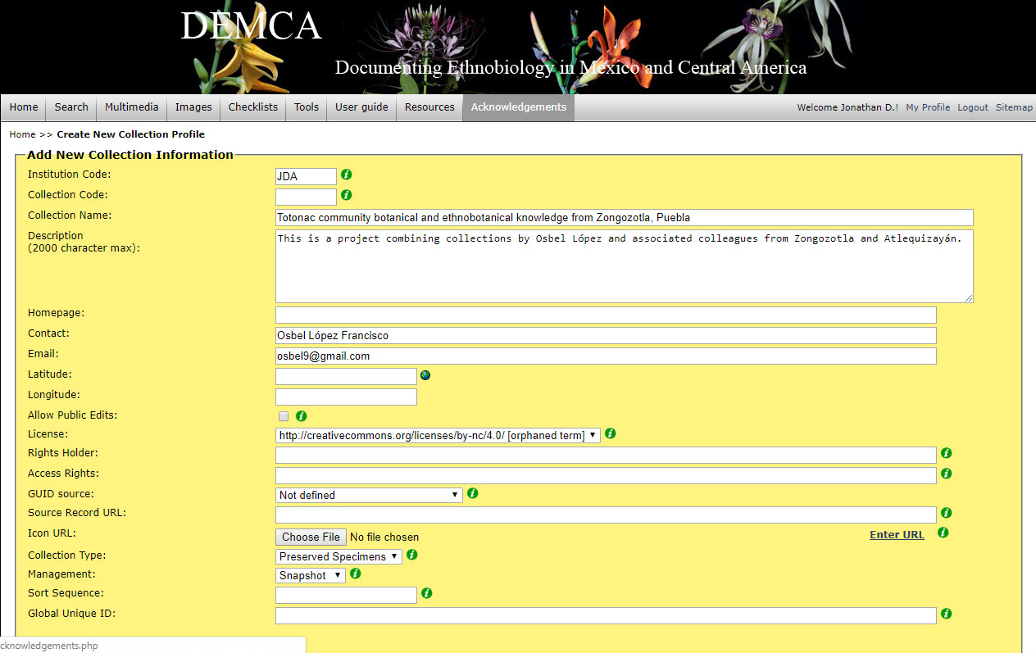
DEMCA: Creating a project
Upon request super administrator sets up a project and assigns permissions
Superadministrator sets up a project with a lead contact (project manager), in this case Osbel López Francisco
Notes:
Super administrator sets up a project with a contact/manager. Note that at present all projects much have an Institution Code. For this project the code thought of at the moment was simply JDA (my initials). Probably something like Zongozotla would be better. This can be changed.

Slide 6
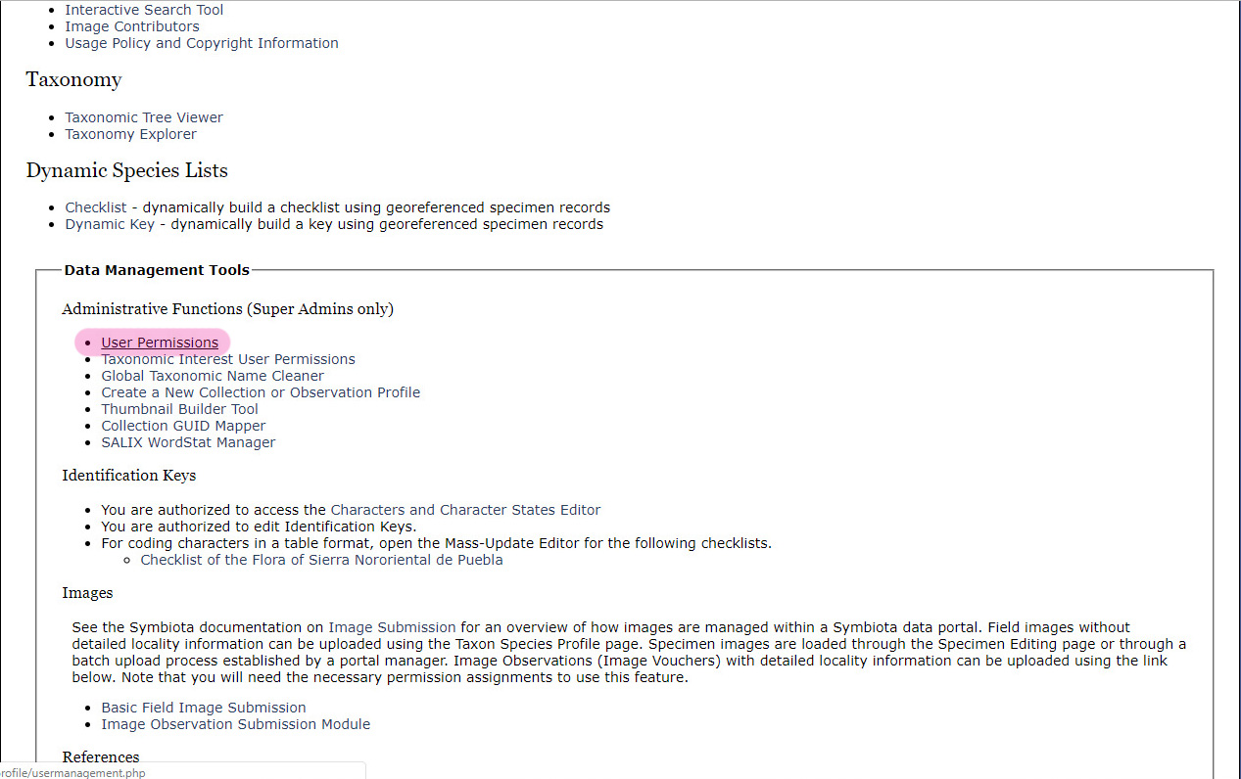
DEMCA: Creating a project
Upon request super administrator sets up a project and assigns permissions
Super administrator then goes back to Data Management Tools and selects User Permissions
Notes:
Once the project is created the Super administrator assigns permissions. Again this is accomplished through the Data Management Tools dashboard.

Slide 7
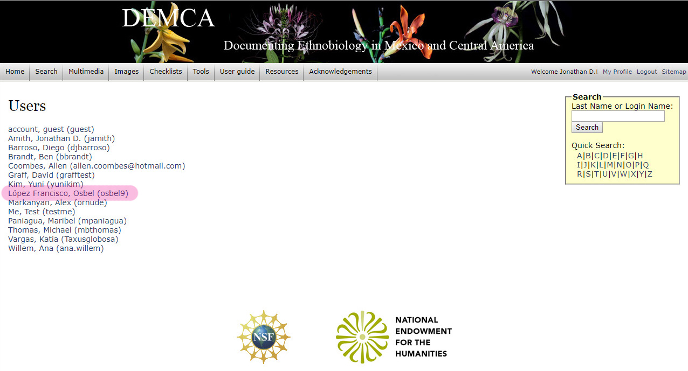
DEMCA: Creating a project
Upon request super administrator sets up a project and assigns permissions
The super administrator sees a list of all registered users and assigns permissions as required.
Notes:
Note that the Super administrator is then presented with a list of registered users and this allows him/her to select a given user and grant different levels of permission.
NOTE: in the future as anyone who wants to comment needs to register it will be necessary to separate out different levels of users:
Users who can only view the DEMCA site
Users who can view and annotate the DEMCA site
Users who can manage a project

Slide 8
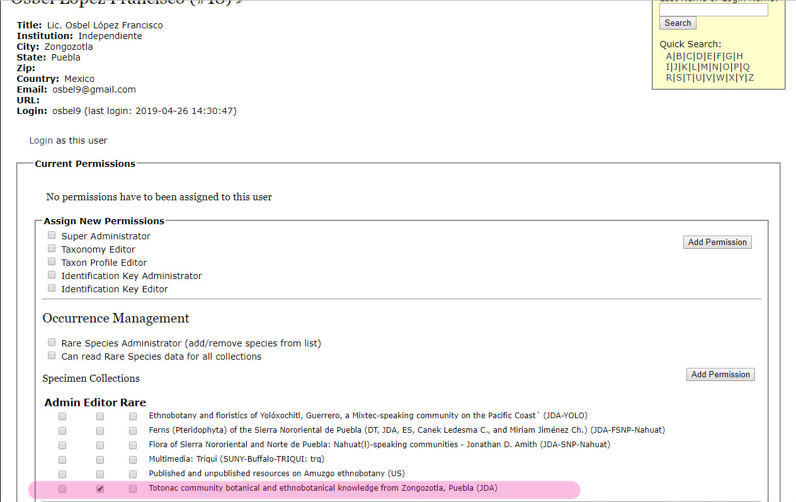
DEMCA: Creating a project
Upon request super administrator sets up a project and assigns permissions
Super Administrator: Has full access to the entire portal.
Taxonomy Editor: Has the ability to add/edit/remove taxa in the portal and edit exiting taxa relationships and synonymy.
Taxon Profile Editor: Has the ability to add/edit/remove descriptions for taxa existing in the portal.
Identification Key Administrator: Has the ability to manage identification keys within the portal.
Identification Key Editor: Has the ability to add/edit/delete identification key data within the portal
User osbel9 is assigned “editing” permissions to the Zongotla project he is managing.
Notes:
The project manager, Osbel López, is given editorial permissions to the project. Other users can be given permissions, but at this point only through the Super administrator.

Slide 9
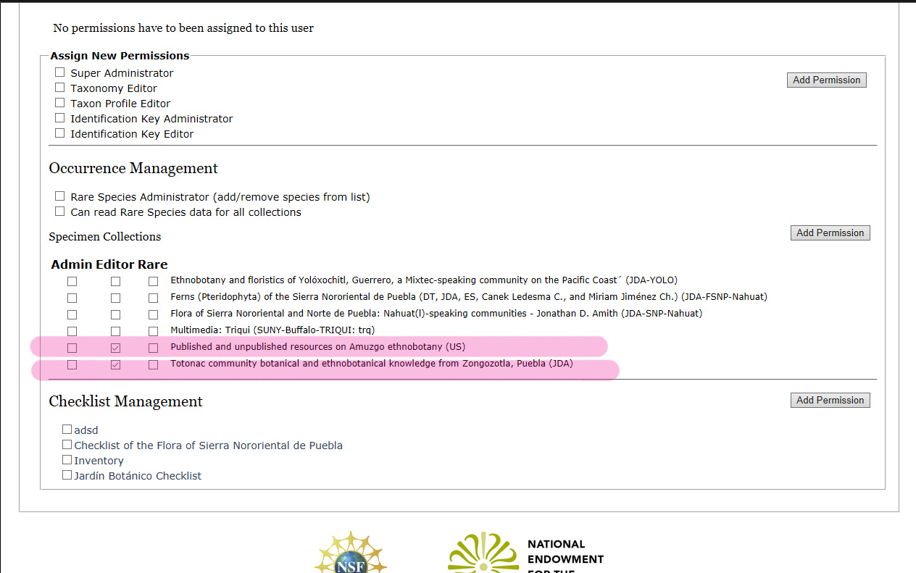
DEMCA: Creating a project
Upon request super administrator sets up a project and assigns permissions
Here the temporary user “Vancouver” is given edit permissions to two projects.
Notes:
A temporary account “vancouver” was set up and “vancouver” was given Editor permissions to two projects.

Slide 10
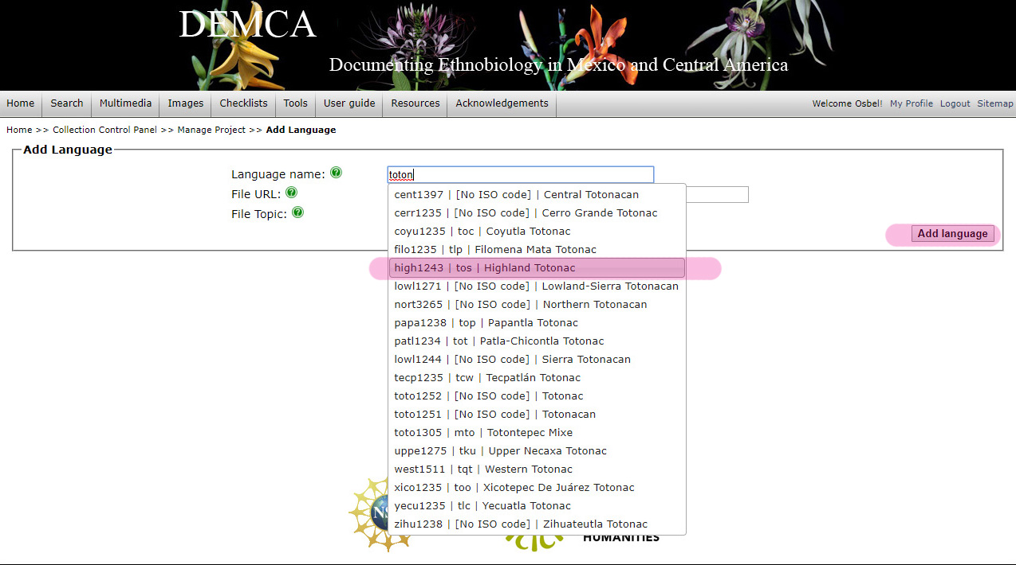
DEMCA: Project management
Building up a database of project languages, communities, and personnel
As the project manager types in the language (language common name, ISO 639-3 code, etc.) a drop-down list appears offering suggestions. Each line contains the Glottolog code, the ISO 639-3 code, and the common name. Note the absence of ISO codes for various units (unspecified and higher levels in the taxonomic hierarchy)
Notes:
Note the importance of the taxonomic hierarchy in Glottocode that allows monophylectic searches as well as polyphylectic and paraphylectic searches.
As a language is typed in a drop-down list of potential matches is displayed; the manager then selects the correct language.
Note that many languages have a Glottocode, an ISO 639-3 code, and a common name. There are two reasons that a language many not have an ISO code
It is a higher level unit, and ISO is simply a code for terminal taxa. Note the advantage of a taxonomic hierarchy for languages to facililtate comparative searching.
It is a terminal language that is not classified in ISO though it is distinctly classified in Glottocode.

Slide 11
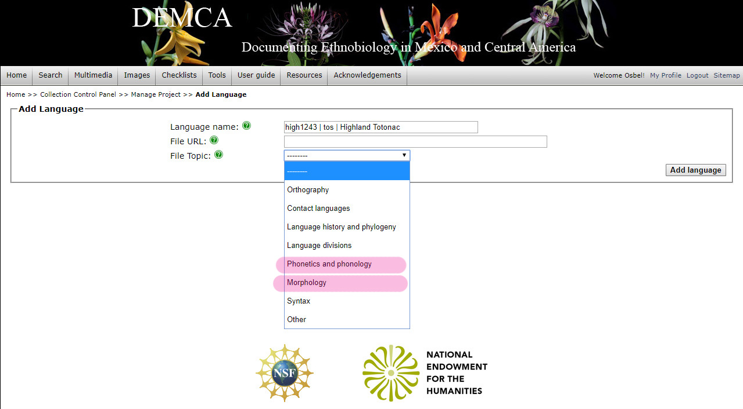
DEMCA: Project management
Building up a database of project languages, communities, and personnel
One difficulty is interpreting even the most simple language resource is the lack of associated data on orthography, phonology and phonetics, morphology. DEMCA allows additional resources (e.g., a description of the practical orthography) to be linked to any language.
Notes:
Note that it is important to link documents to languages. These might be a description of the orthography used in the ethnobiological documentation. It might be a discussion of language relations and phylogeny. These articles may be published, or part of the corpus produced by the project participants.

Slide 12
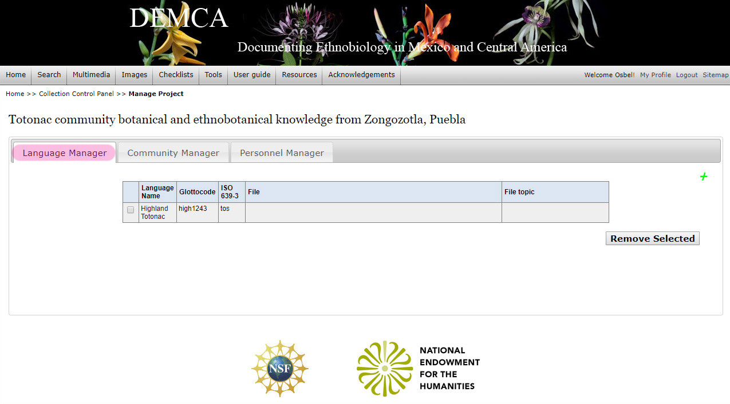
DEMCA: Project management
Building up a database of project languages, communities, and personnel
After language is saved it appears on the control panel. Note the columns (File and File topic) for supporting literature. The language can be removed (checked and Remove selected) or another vernacular language can be added (click green plus).
Notes:
Here we see that the language is saved with
Name
Glottocode
ISO 639-3 code
Space (a column) is available to list linked files and their topics.

Slide 13
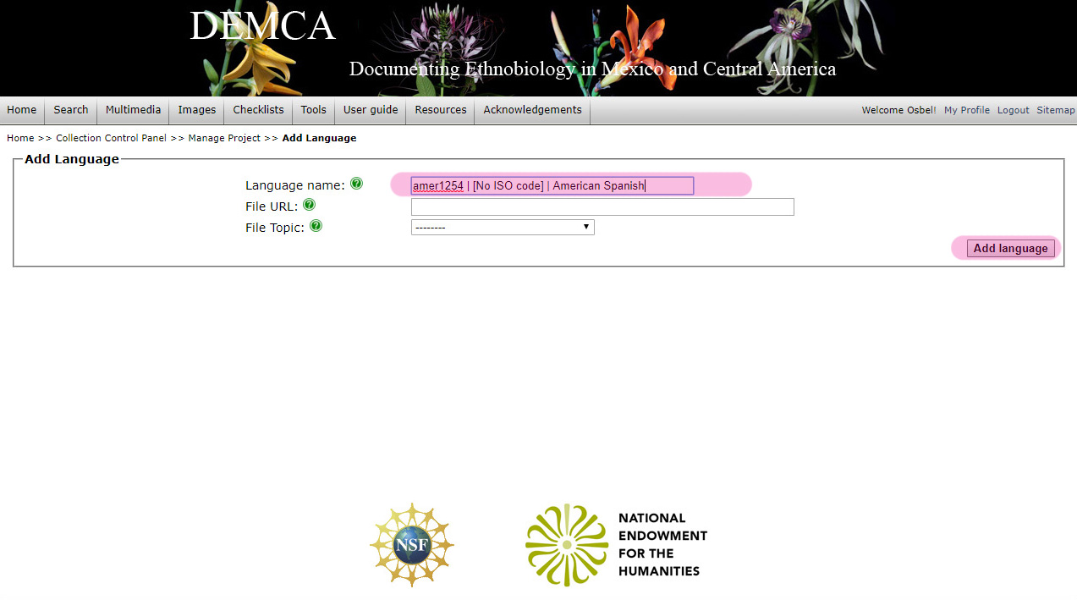
DEMCA: Project management
Building up a database of project languages, communities, and personnel
Colonial language as vernacular language: Provisionally it has been decided to consider a colonial language as another local/regional vernacular (as opposed to scientific name). It is important to include this information as often it will be the case that searches across communities speaking different indigenous langauges will benefit, particularly before scientific names are determinied, from search on local Spanish names. It may also be that the Spanish vernacular functions to link two entries from a given community with distinct Indigenous vernacular names.
Notes:
Here a second language is added. In this case it is American Spanish.
The question that was discussed was how to deal with regional Spanish names of flora and fauna (or, in the case of Native American names, English). The reason it is important to have these is because two names function to permit comparative study: scientific nomenclature and Spanish.
The regional colonial vernacular may, at least in initial stages, be the only way to link two Indigenous names from very distinct languages to the same referent.
Scientific nomenclature. Again, this provides the most commonly used lingua franca for x-cultural comparison.

Slide 14
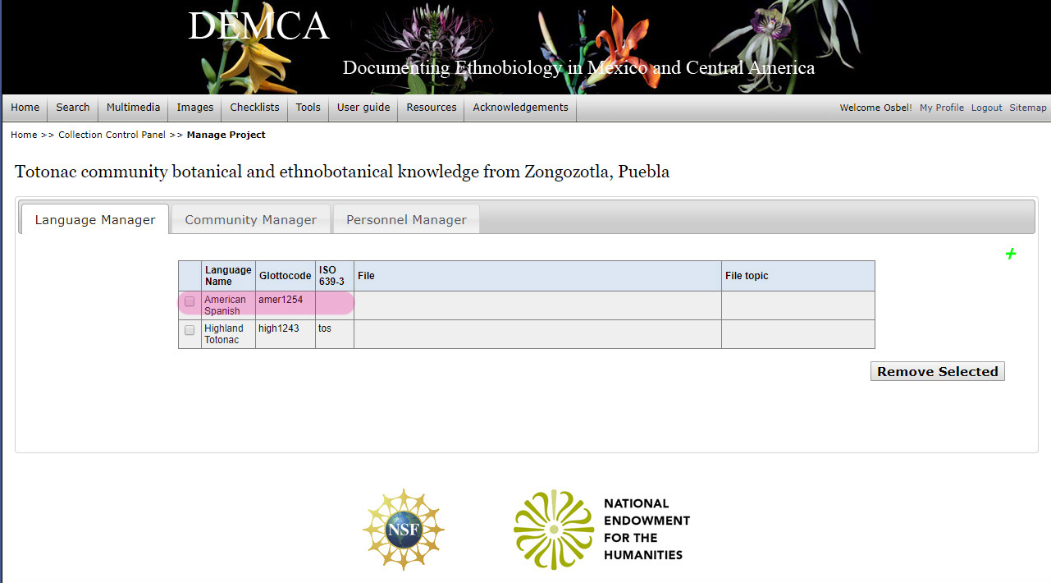
DEMCA: Project management
Building up a database of project languages, communities, and personnel
Spanish has been added as a second vernacular language for ethnobiological data from Zongozotla. A third language, Nahuat, could also be added.
Notes:
Note that all pertinent languages must be in a project. In the case of Nahuat the field botanist was a native speaker who also gave ethnobotanical information.

Slide 15
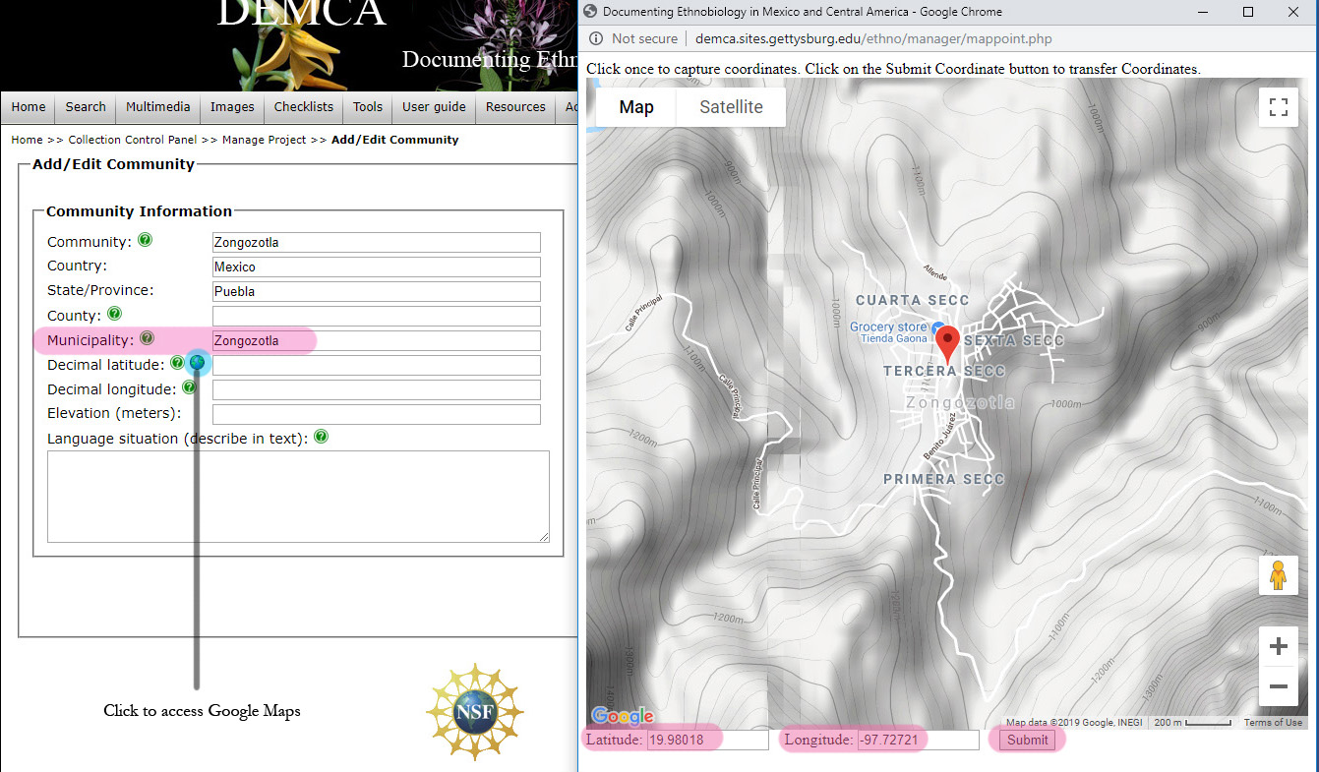
DEMCA: Project management
Building up a database of project languages, communities, and personnel
Notes:
All communities within a project must be listed. Note that the coordinates can automatically be interested through Google Maps. However, elevation must be inserted manually (e.g., via using Google Earth). Note that the correspondence of mpio and county will vary by country.

Slide 16
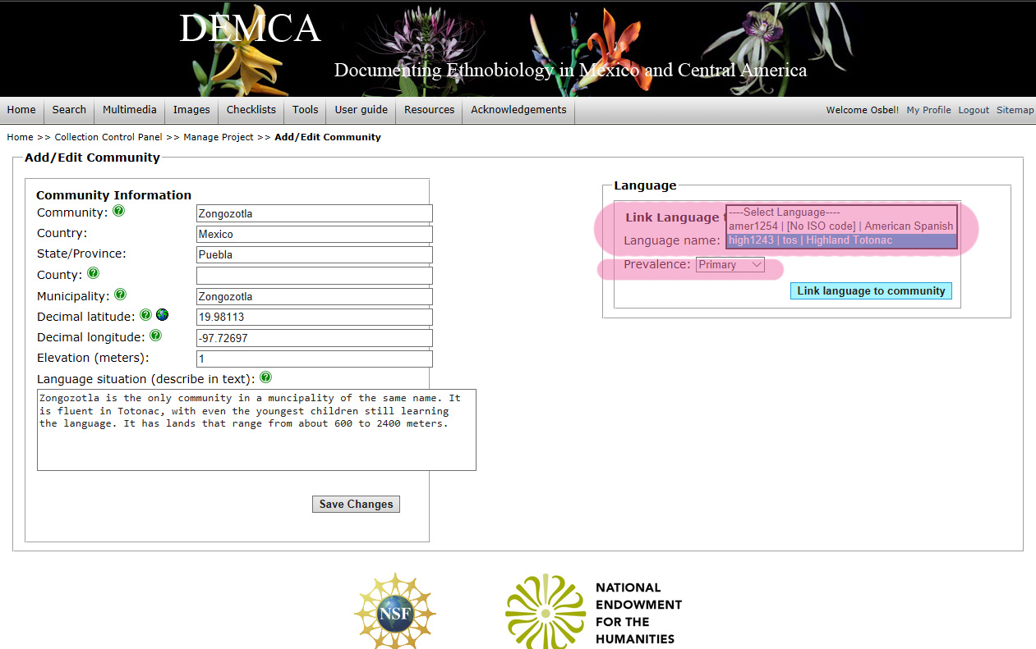
DEMCA: Project management
Building up a database of project languages, communities, and personnel
Add languages to community module (profile). The first language could be the primary Indigenous language spoken in the community, selected from a drop-down menu of all languages already integrated into the project. Only this languages can be added to a community profile.
Notes:
Languages are linked to the one or more communities in a project.
Emphasize that only languages in the project can be linked to a community.

Slide 17
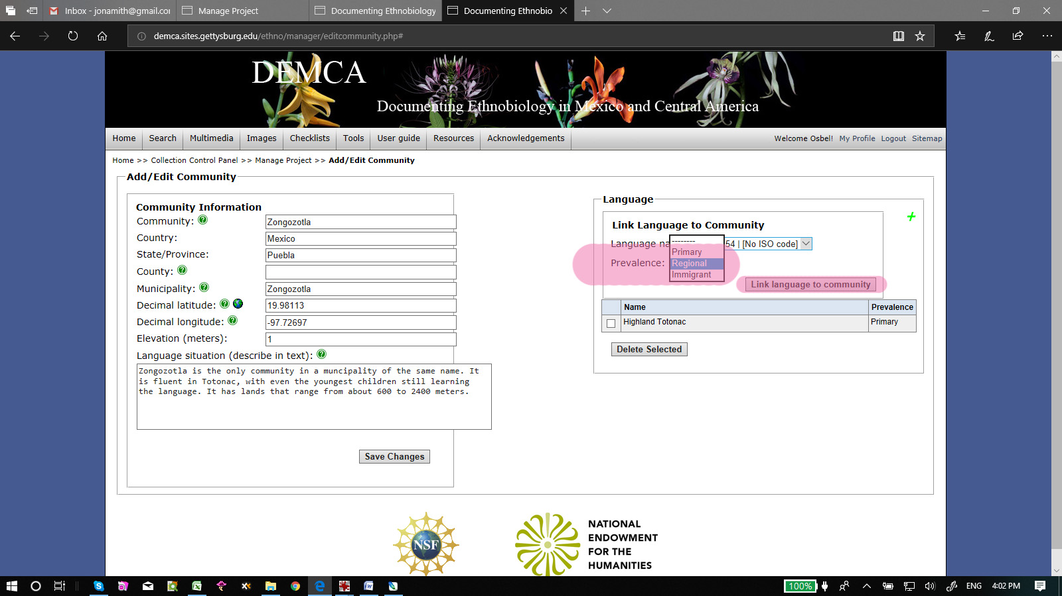
DEMCA: Project management
Building up a database of project languages, communities, and personnel
A second language, in this case regional, is added to the community profile. Note again that only languages associated with the project can be added to a community.
A second vernacular language is added to the primary one. This second language is “regional,” i.e., the colonial regional language.
Notes:
The community language can be “primary”, “regional” or “immigrant”. Basically this corresponds to the basic Indigneous language, the colonial language, and other Indigenous languages spoken by immigrants.

Slide 18
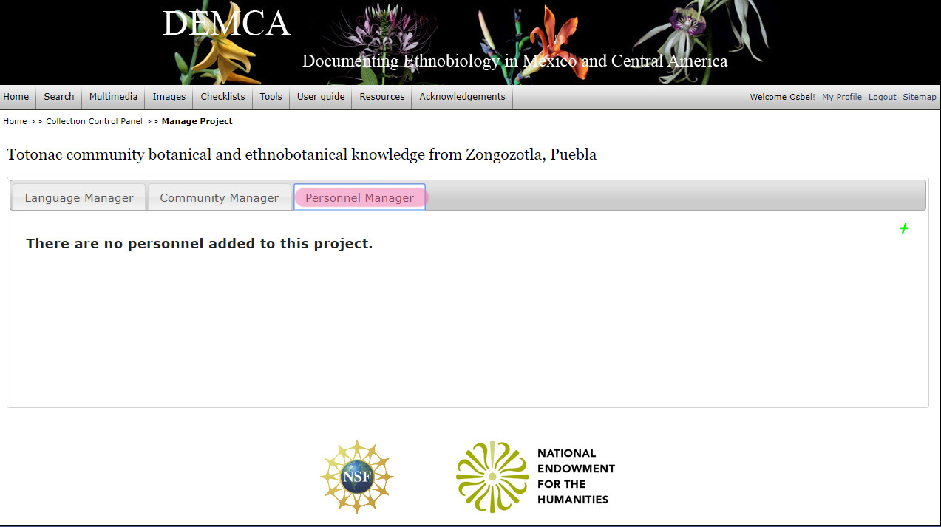
DEMCA: Project management
Building up a database of project languages, communities, and personnel
Personnel Manager: The final module for project set-up is the Personnel Manager. First languages are added and the languages associated with the project are the only ones to which a community, that is added second, can be linked. Finally, when the inventory of Languages and Communities is set, Personnel are added, with each individual linked to a community (or two, if a migrant) and to one language or more.
Notes:
The last module to be developed is a personnel module: All individuals (minimally all consultants) who participated in a project.

Slide 19
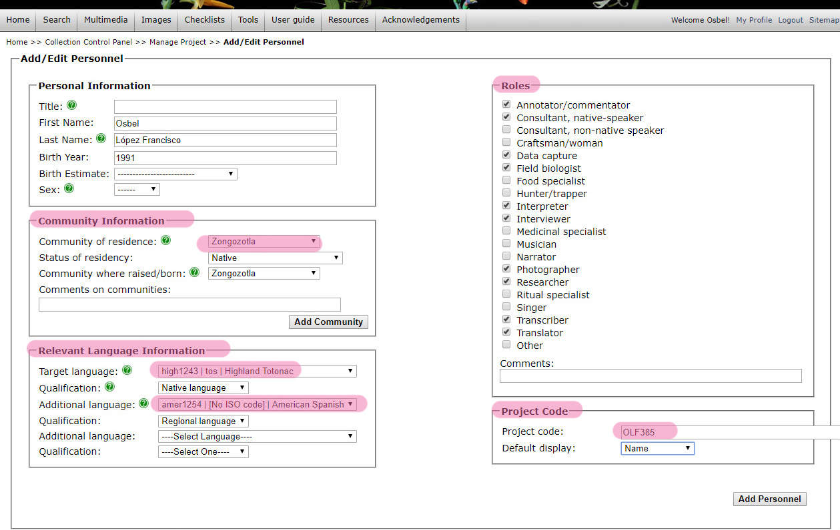
DEMCA: Project management
Building up a database of project languages, communities, and personnel
Personnel are added to the project. Personnel are linked to communities and languages: Only communities and languages already in the project description are possibilities. Each personnel’s roles is also listed as is the display of this person.
Notes:
This input form is the complete form for all project personnel. It comprises
Personal data
Language data
Role data
Presentation data (how the person is displayed in search results)

Slide 20
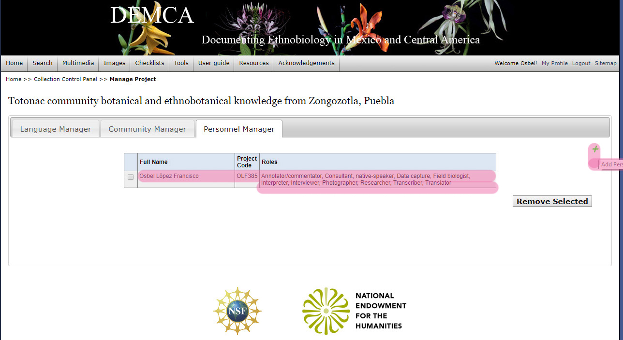
DEMCA: Project management
Building up a database of project languages, communities, and personnel
Personnel is added to the Personnel Manager dashboard form with full name, project code, and roles. When searches yield information by this speaker display can either list the speaker’s full name, project code, or a random DEMCA generated yet constant code. Additional personnel can be added without limit (click + in upper right)
Notes:
Once an individual is entered the personnel table (in many ways parallel in content to the language and community tables) his or her data can be edited.
All project personnel should be listed, particularly those who give information on ethnobotanical knowledge.

Slide 21
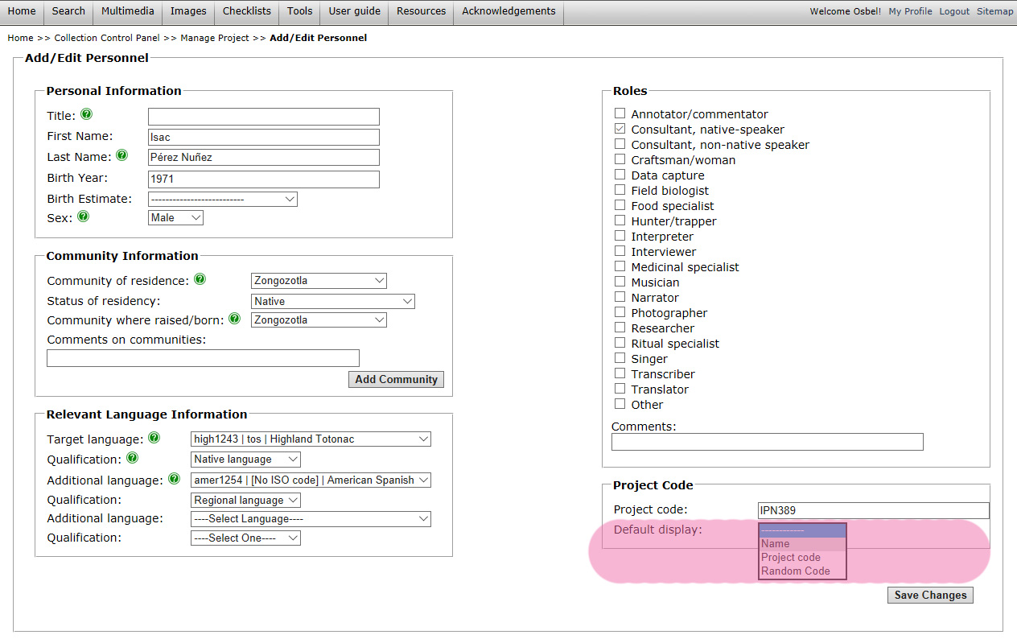
DEMCA: Project management
Building up a database of project languages, communities, and personnel
Personnel can be added to a project at will. The project manager can select how each individual is display to the public: by name, by project-specific code, or by a random code generated by DEMCA.
Notes:
But note that there are various ways that the identity of the person can be kept confidential. Discuss this question of anonymity and confidentiality.
Name
Project code (i.e., assigned by the fieldworker, project manager, etc.)
Random code (no semantics)

Slide 22
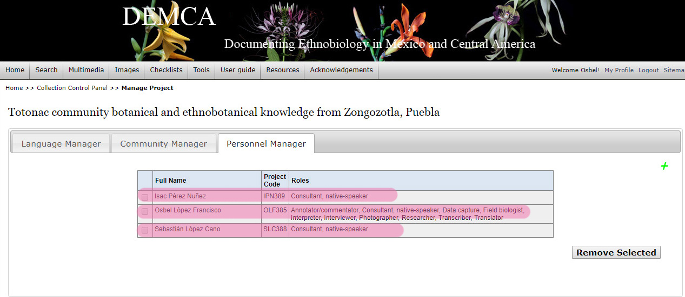
DEMCA: Project management
Building up a database of project languages, communities, and personnel
A completed Personnel Manager dashboard will show all project personnel along with their respective roles. Included as well is their project-specific code.
Notes:
More and more participants are added.

Slide 23
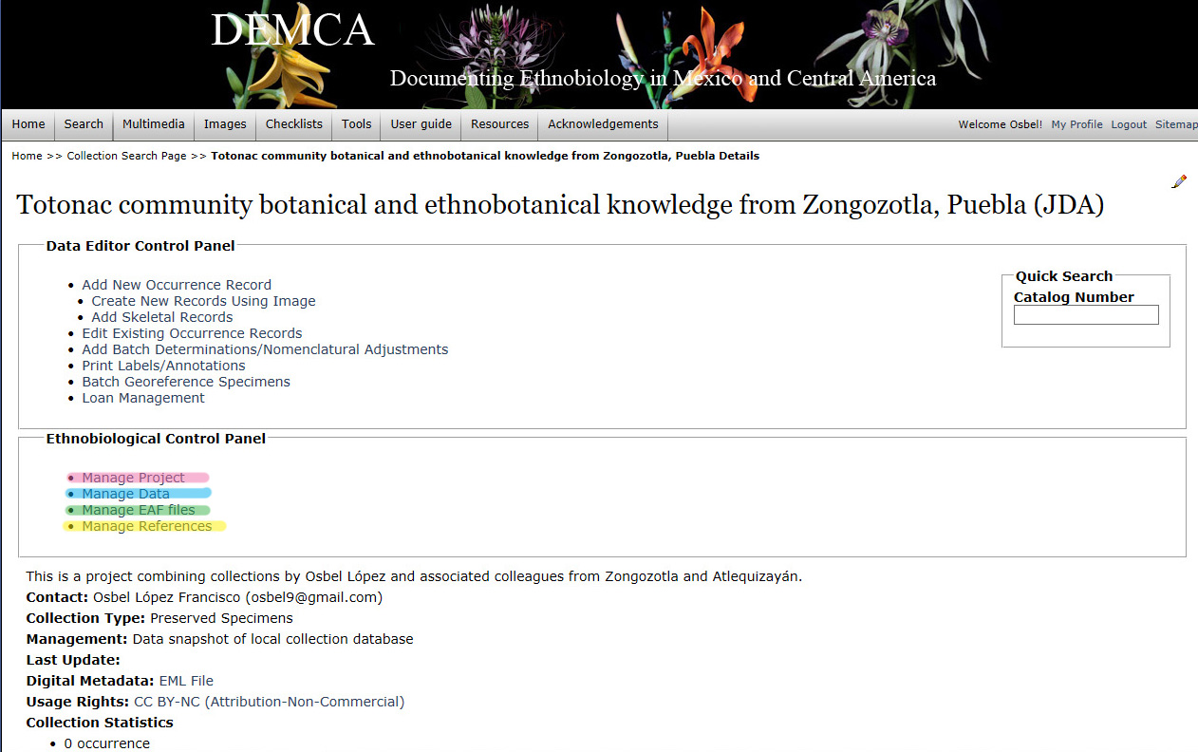
DEMCA: Project development
Overall structure for data input through the dashboard
Project manager can manage the ethnobiological project in four dimensions.
Notes:
Each one will be dealt with in the following slides.

Slide 24
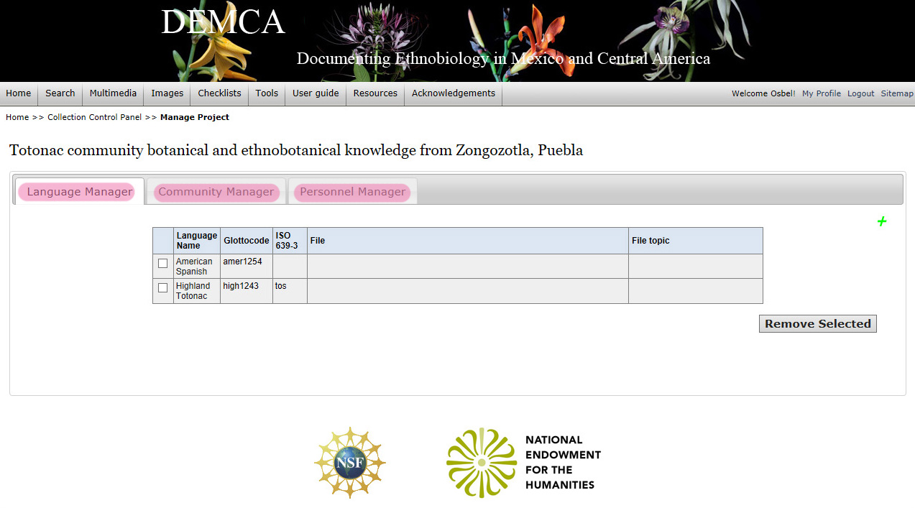
DEMCA: Project development
Manage Project: Language, community, and personnel modules
The Manage Project module can be accessed at any time and Project manager can modify the content of the Language, Community, and Personnel modules.
Notes:
The project can be “managed” at any time, meaning that the content of the
Language module
Community module
Personnel module
Can be altered, enhanced, etc. at any time.

Slide 25
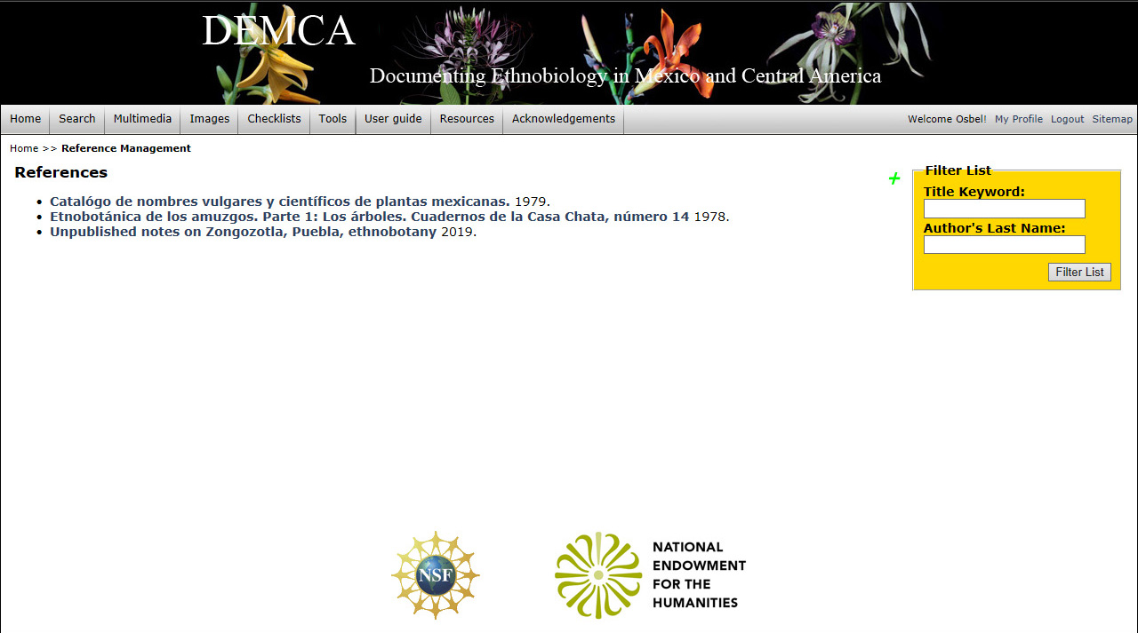
DEMCA: Project development
Manage References: Adding resources as sources of ethnobiological data
The Manage References module can be accessed at any time and the Project manager can add references to the portal, which can then be specifically associated with any specific project.
Notes:
One significant facet of DEMCA is the ability to add ethnobiological data from a wide range of published, unpublished and archival resources. The resources are added to the portal but may be linked to particular projects. In this case an “imaginary” ms of Zongozotla plant names is treated as a ms/unpublished resource.

Slide 26
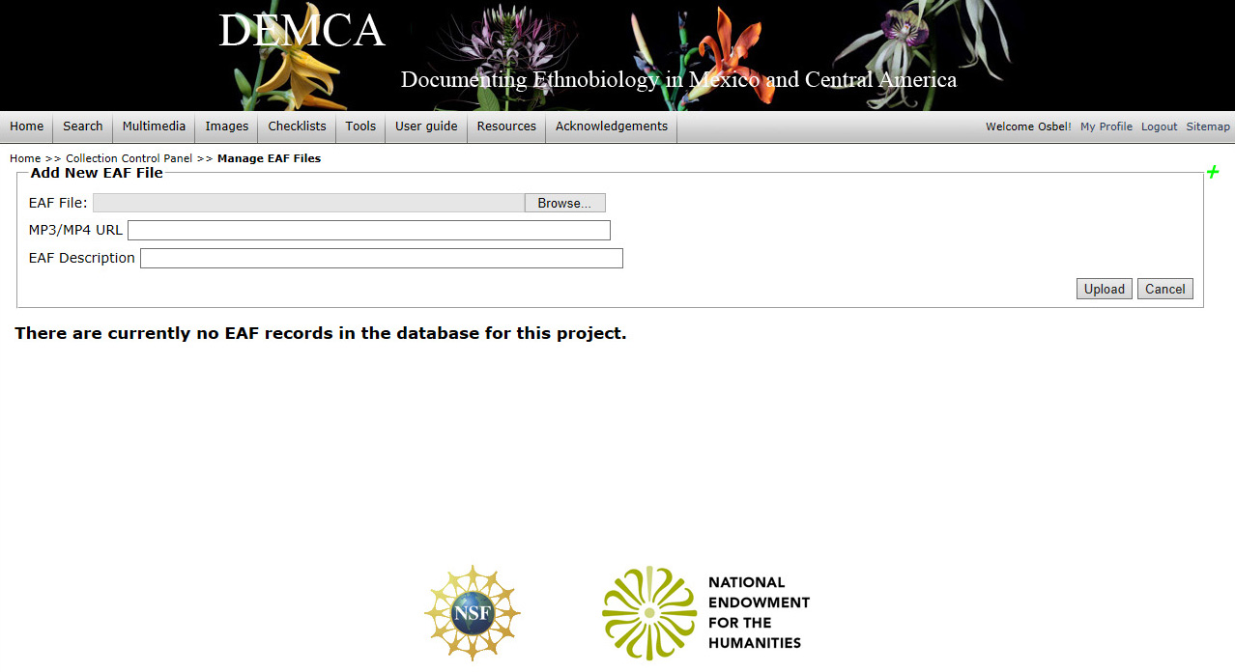
DEMCA: Project development
Manage EAF files: Adding audio-visual links to an ethnobiological project
EAF files are time-coded transcriptions and translations of audio and video recordings. They can be displayed, through DEMCA in line-by-line playback (see http://demca.sites.gettysburg.edu/ethno/eaf/index.php) .
Notes:
Another development in DEMCA is the ability to link audio visual information to taxonomic descriptions. This is done through the Manage EAF files function.
Give an example of how this works. Use the Nahuat and the Yolo playbacks.

Slide 27
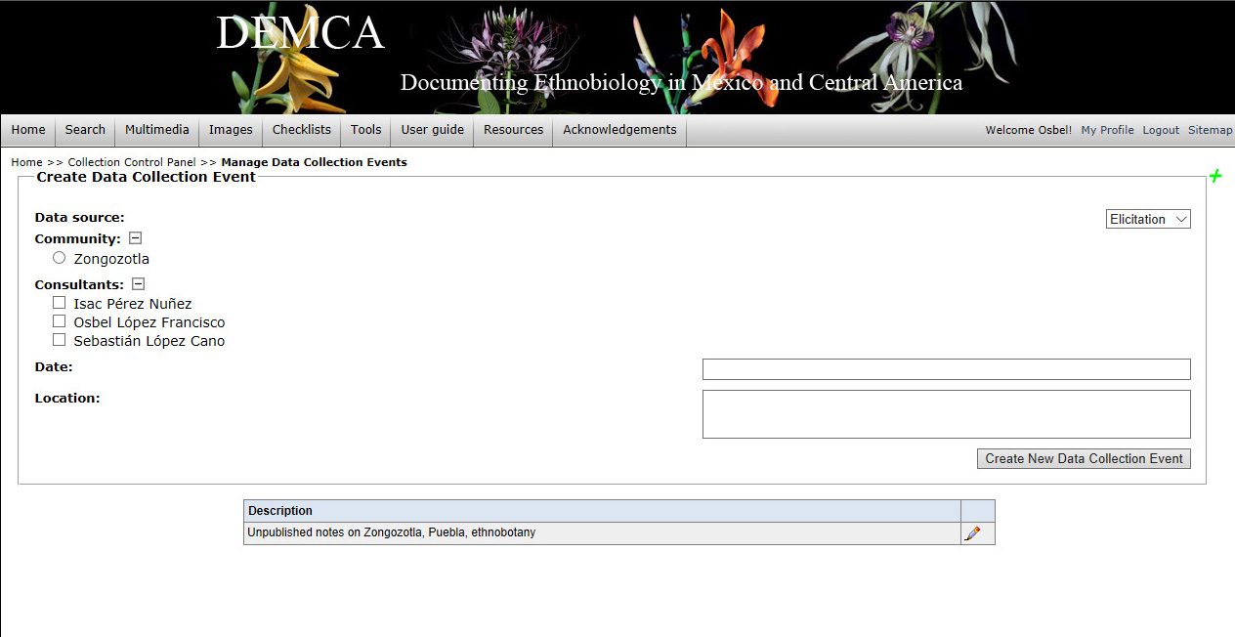
DEMCA: Project development
Manage Data: Adding data to any of the three types of “resources”
1. Field collection and observation; 2. References; 3. Elicitation
Notes:
Final, within a project data can be “managed” added. In the present project there are two sources of data
Physical specimens and observations
References (ms)

Slide 28
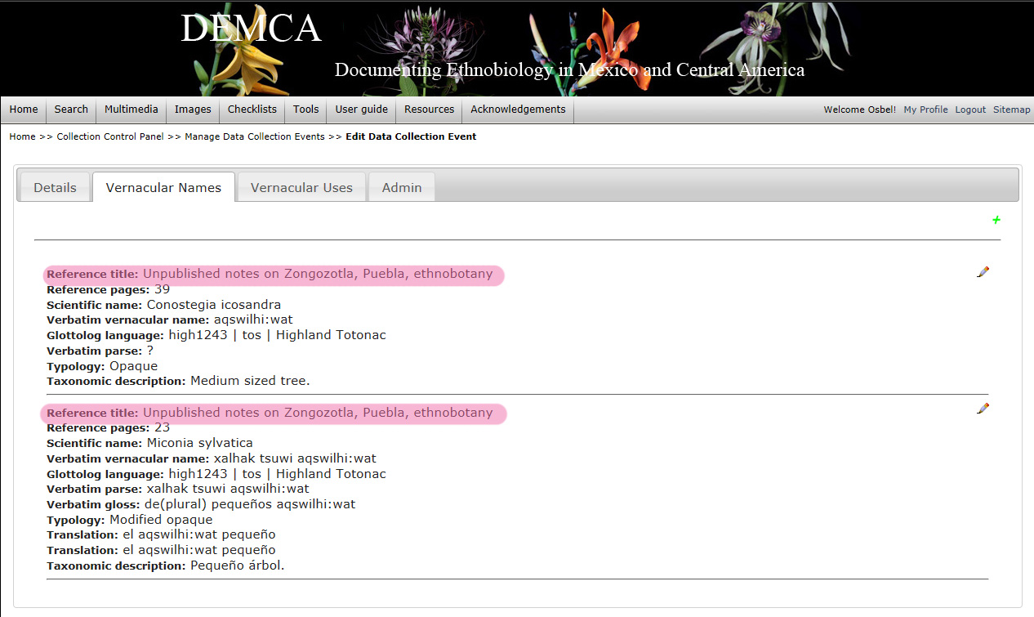
DEMCA: Project development
Ethnobiological data: Vernacular names listed from an unpublished resource
Summary representation of data from a reference.
Notes:
Some reference data has already been added (see summary data, that can be edited)
Then Vernacular Names and Vernacular Uses can be added.

Slide 29
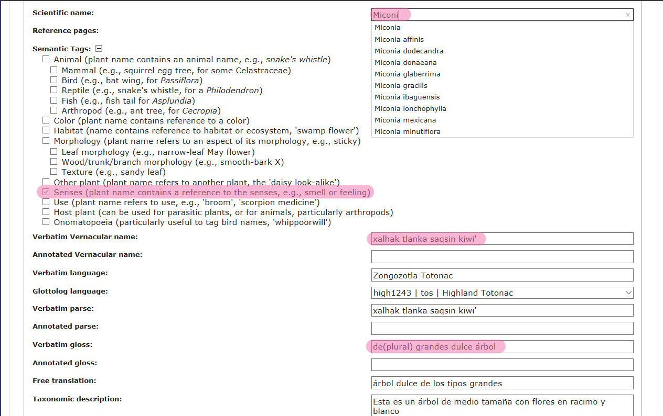
DEMCA: Project development
Ethnobiological data: Adding vernacular names from an unpublished resource
Notes:
The above data input form for vernacular name shows how DEMCA handles this. Several important points
DEMCA, like Darwin Core, divides data into “verbatim” and, in this case called, “annotated”.
Indigenous names are parsed and glossed (to facilitate discovery of calques)
Vernacular languages are specified via Glottocode tags
A series of semantic tags are added to facilitate searching across languages (e.g. all plant terms with reptile names in the plant name)

Slide 30
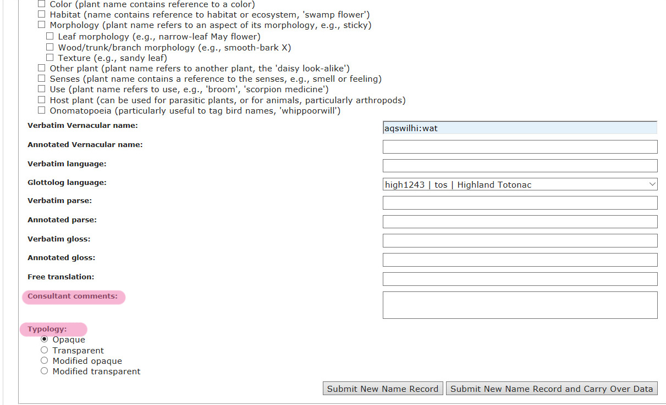
DEMCA: Project development
Ethnobiological data: Adding vernacular names from an unpublished resource
Consultant comments allows entry of consultant comments on vernacular name (e.g., its justification). Typology refers to the transparency or opacity of the vernacular name and its structure as one or more than one words.
Notes:
Consultant comments are here intended to allow consultants in a field situation to discuss meanings.
There is a way to tag whether the term is opaque, transparent, etc.

Slide 31
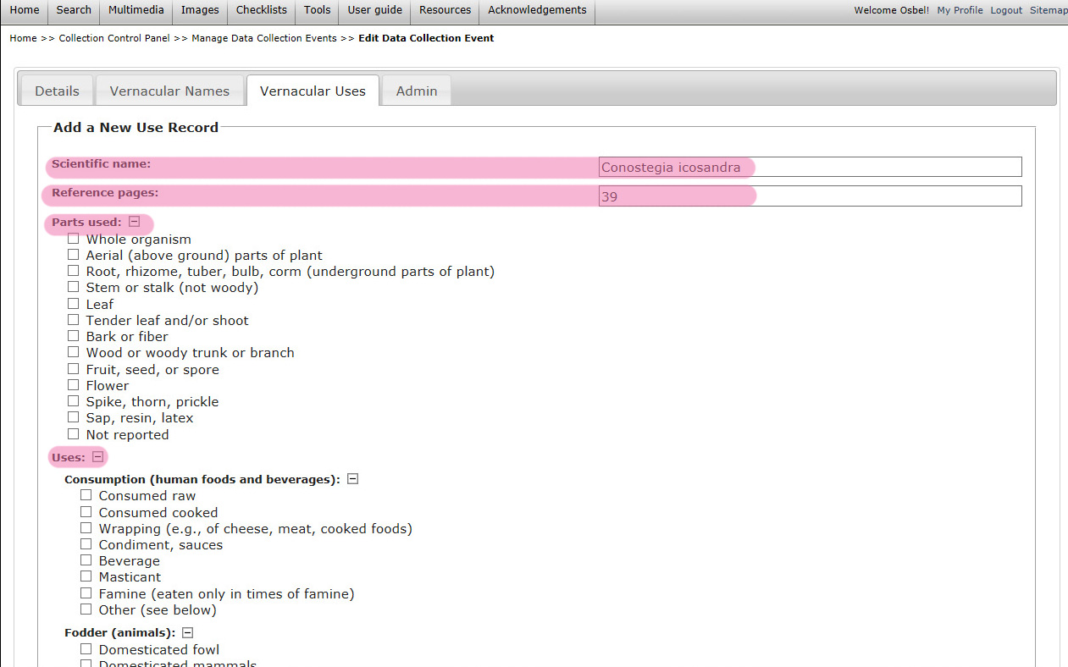
DEMCA: Project development
Ethnobiological data: Adding vernacular uses from an unpublished resource
Notes:
The final input form is for Use. This is divided into
Part of plant used (note generalities)
Use (divided into general types)
All specific uses under a heading will be discoverable by higher levels.

Slide 32
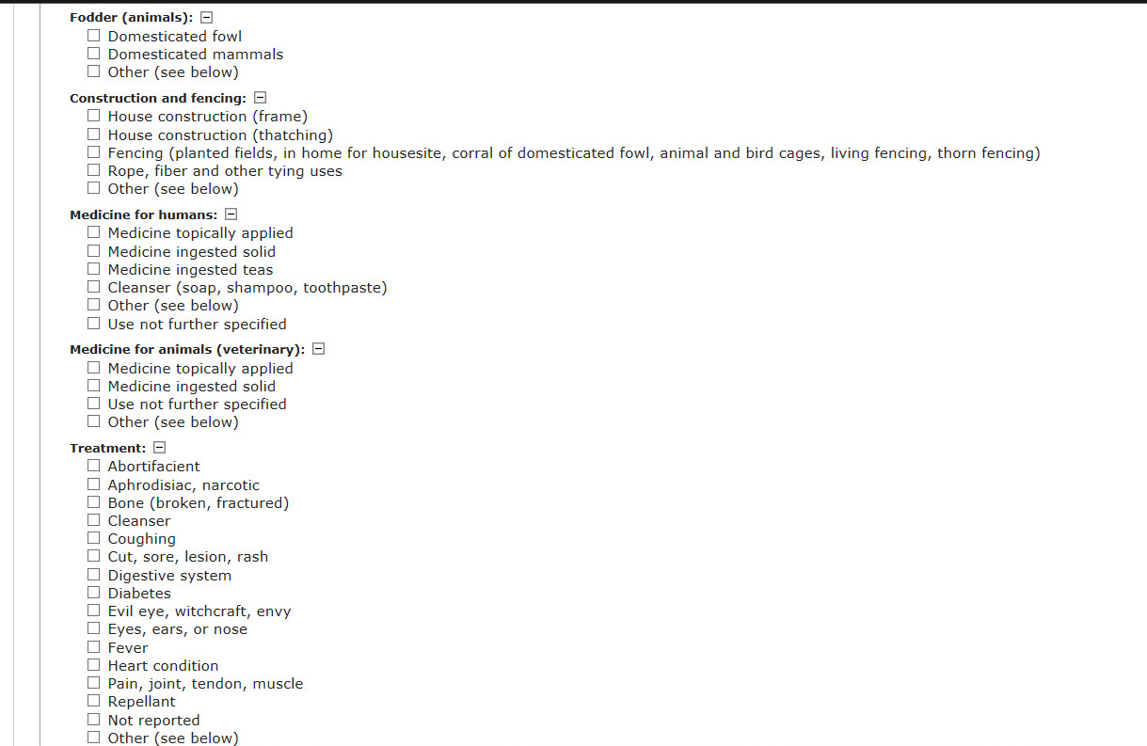
DEMCA: Project development
Ethnobiological data: Adding vernacular uses from an unpublished resource

Slide 33
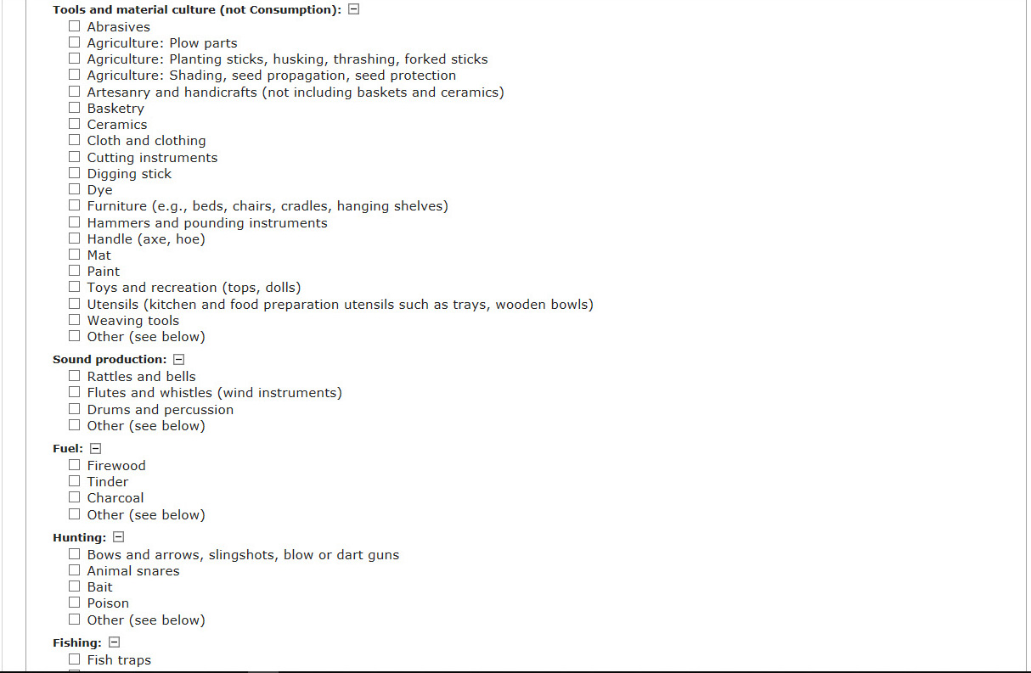
DEMCA: Project development
Ethnobiological data: Adding vernacular uses from an unpublished resource

Slide 34
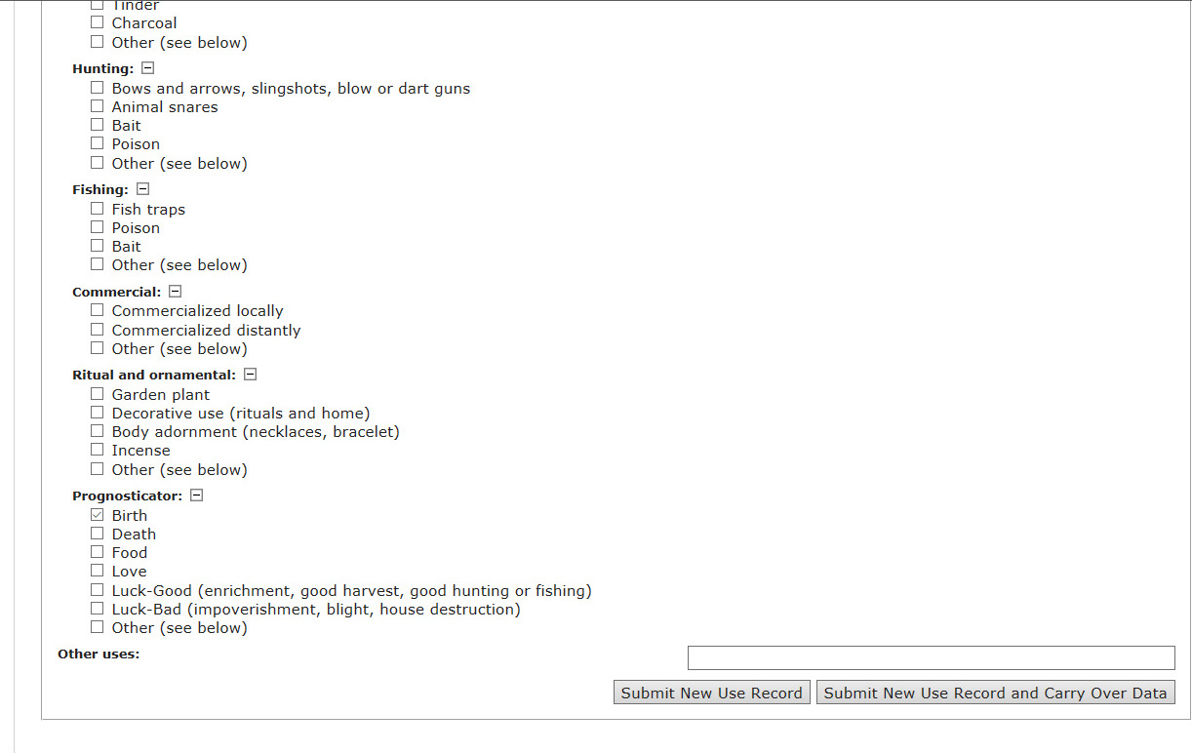
DEMCA: Project development
Ethnobiological data: Adding vernacular uses from an unpublished resource

