Slide 1
Reconstruction in Ethnobiological Systems of Australian Languages
Claire Bowern
Yale University
(Work in progress with Patrick McConvell)

Slide 2
Introduction

Slide 3
‘Dynamics of HG Languages’
3-year NSF-funded project
Interdisciplinary
Claire Bowern (Yale)
Patience Epps (UT Austin)
Jane Hill (U Arizona)
Keith Hunley (U New Mexico)
Patrick McConvell (ANU)
Russell Gray (Auckland)
Jack Ives (Calgary)

Slide 4
‘Dynamics of HG Languages’
Reconstruction of prehistory in three case study regions:
Northern Australia (Kimberley and surrounds)
Northern Amazonia
Southern California and the Great Basin

Slide 5
‘Dynamics of HG Languages’
Comparative work between case study areas in various domains:
Basic vocabulary and borrowing (Bowern et al forthcoming)
Numeral systems (Zentz and Bowern, Epps and Hanson)
Flora and Fauna
Kinship (Ives, McConvell and Hill)
Grammatical and phonological systems
Language shift and genetics
…

Slide 6
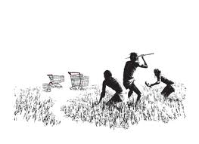
Why reconstruction in ethnobiology?
Words representing items which cross-cut
Food
Toolkits
Trade items
Culture

Slide 7
Why reconstruction in ethnobiology?
Have been very important in reconstruction more generally:
Woerter und Sachen: reconstructing culture
Reconstructing paleoenvironments
Reconstructing loan-patterns
Data from acculturation
Inferences from Wanderwoerter tracks
cf. Mallory, Bloomfield, Evans and Jones, McConvell, etc

Slide 8
Roadmap for Today
Empirical investigation of the domain of flora and fauna in a subset of (Pama-Nyungan and Non-Pama-Nyungan) Northern Australian languages
Structure of the nomenclature system
Etymology
Borrowability
Implications
For work on Hunter-gatherer languages
For reconstruction and prehistory research in Australia

Slide 9
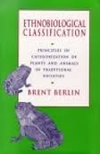
Universals of Ethnobiology
Berlin (1992)
17 languages (10 cultivator, 7 non-cultivator (HG), including Anindilyakwa)
HG languages tend to have
No unique beginner terms
No or Few life form terms
Many species terms
Few varietal terms
Few hierarchical levels [cultivator average is 4-5 levels]

Slide 10
Sampling problem?
7 non-cultivator languages
4/7 from Pacific North-West [USA/Canada]
Navajo [!]
Anindilyakwa
1 from Central America
Berlin’s sample was therefore biased towards a specific ecosystem and linguistic area.

Slide 11
Brown (1977)
39 Languages
3 Australian [Kukatja, Gupapuyŋu, Anaindilyakwa]
20 HGs
Bias towards Central America, Pacific Northwest, and Philippines
Exhaustive surveying (all languages with detailed ethnobiological descriptions)

Slide 12
Brown (1977), Witkoski, Brown and Chase (1981)
Complexity in ethnobiological nomenclature is directly related to complexity in social structures (and in use of cultivation)
Terms for 'tree' and other general biological categories such as 'grass', 'vine', 'fish' and 'bird‘ are relatively recent additions to languages. These broad categories have probably developed in response to most individuals being removed from daily intimate contact with the world of plant and animals as societies have increased in size and complexity.

Slide 13
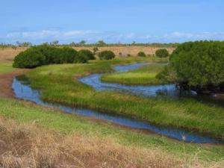
Diversity in Australian Ethnobiological systems
Life Form generics (tree, grass, animal, snake, etc)
Present and reconstructible in Yolŋu, Nyulnyulan, Paman, etc
Tend to be absent in Victorian languages, Wati languages (e.g. snake); Anindilyakwa

Slide 14
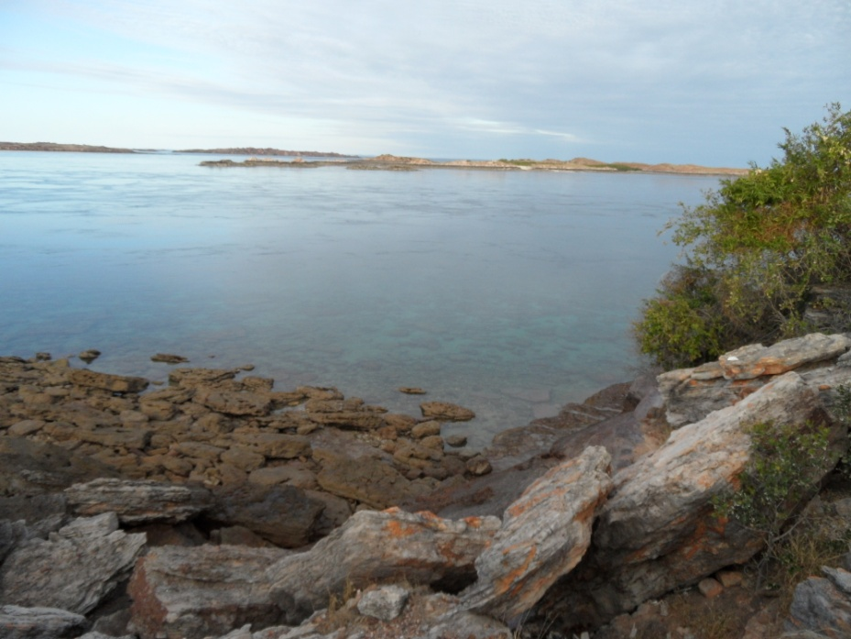
Bardi system
Life forms (including):
Bardag ‘tree’ (<*bardaŋka)
Gooljoo ‘grass’ (<*kulju)
Aarli ‘meat’ (<*waarli)
Goorlil ‘turtle and dugong’ (<*kurlibil)
Mayi ‘vegetation’ (Kimberley WW)
Compound macro-life-forms
Aarli-barnangg ‘meat-shellfish’
Aarli-goorlil ‘meat-turtle’
[no unique beginner, but cf. the things which can be described as noonyji ‘alive’]

Slide 15
Interim summary
Considerable diversity in Australian nomenclature systems, at least in organisation
[keep an eye on reconstructibility and etymology of life forms]

Slide 16
Etymologies of Australian Ethnobiological systems

Slide 17
Methods

Slide 18
Survey Sample
37 Australian languages
Nyulnyulan [6] - CB
Bunuban [2] -PMc
Wororan [3] – Stef Spronck
Jaragan [3] - PMc
Wardaman [1] - PMc
Mirndi [1] - PMc
Pama-Nyungan
Marrngu [3] - CB
Ngumpin-Yapa [5] -PMc
(Paman and Cape York) BA

Slide 19
Survey Sample
125 items of flora/fauna common across the area, including:
17 generics (shell, tree, insect, shark, etc)
22 ‘inland’ items
21 ‘sea’ items
31 birds
8 fish
24 insects, arachnids, etc
11 mammals
10 reptiles (mostly snakes)
12 trees

Slide 20
Survey Coding
Code | Example (from Bardi)
Inheritance | Bardag ‘tree’ (<*bardangka)
Loan | Wiraj ‘owl’ (< Yawuru wiraj)
Unique | Garrjarl ‘frog’
Unknown
Missing | Death adder
Semantic Shift | Aambarn ‘moth’ (< stingray sp)
Loan into Proto-Language | Arriyana ‘eaglehawk’ (< P-Ny language *warrakana )
Loan direction unknown | Baarni ‘goanna’ (Wanderwort)

Slide 21
Loan Statistics

Slide 22
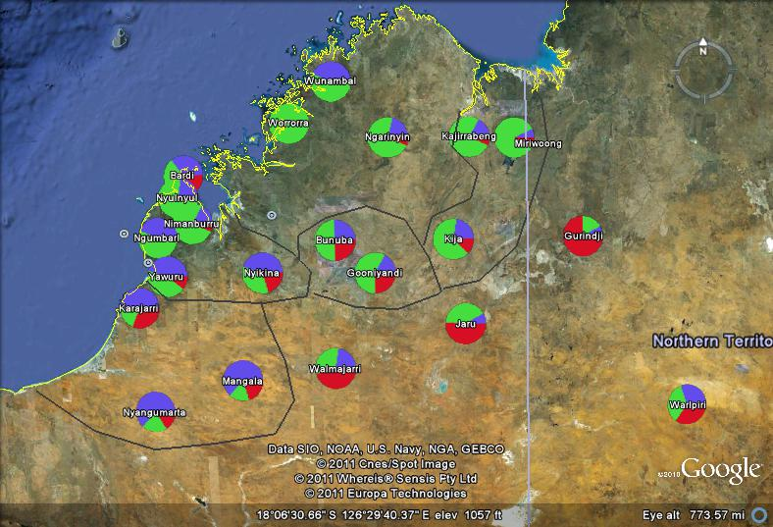

Slide 24
Language Loans
Flora/fauna loans either exceed or track loans in basic vocabulary, with the exception of Gooniyandi

Slide 25
Loans by type

Slide 26
Most commonly loaned
Item | % age | Comment
Horse | 97% | Introduced
Pearlshell | 43% | Important Ceremonial and Trade item
Buzzard | 33%
Witchetty Grub | 30%
Red River Gum | 29%
Sappy Gum | 27%
Bat | 26%
Freshwater mussel | 26%
Wedge-tail eagle | 26%
Pelican | 25%
Bluebone | 25%
Freshwater Croc | 24%

Slide 27
Least commonly loaned
Item | % age | Comment
Octopus | 0
Worm | 0
Baler Shell | 0
Tree | 3%
Grass | 3%
Ant | 3%
Louse | 3%
Termite Mound | 3%
Catfish | 3%
Sacred Kingfisher | 3%
Scorpion | 3%
Caterpillar | 3%
Notes:
+ others which I excluded because of low attestation figures

Slide 28
Most commonly inherited
Item | % age | Comment
Camp dog | 78% | ????
Peaceful Dove | 61%
Pied Butcherbird | 55%
Prickle Bush | 55%
Barramundi | 55%
Tree | 54%
Emu | 53%
Fish (generic) | 52% | Also often = ‘meat’
Mosquito | 51%
Torresian Crow | 50%
Centipede | 50%
Flying-foxes, generic term | 47%

Slide 29
Least etymologisable
Item | % age | Comment
Pike eel | 72%
Saltwater mussel | 58%
caterpillar | 57%
Ti-Tree | 57%
Spoonbills | 54%
frog (generic) | 53%
Bush Yam | 50%
Australian snubfin dolphin | 50%
Land Snail | 50%
Baler shell | 47% | [also least commonly loaned]
Goanna | 46%
Octopus | 45% | [also least commonly loaned]

Slide 30
Interim Summary
Wide variety in loan levels across languages
Inheritance levels are low compared to basic vocabulary;
But loan levels are not particularly high.
No clear patterns of borrowing across the area as a whole (though some clear Wanderwoerter)
Few patterns at this level of detail:
Need a more localist approach
Speaks against large-scale linguistic areas in this domain

Slide 31
Interim Summary
Many generics are reconstructible in the region, in numerous families.
Others are Wanderwoerter (e.g. mayi ~ mangarri ‘tucker’)
There are therefore likely to be old.
This provides a counter-example to Brown’s and Berlin’s claims about the role of generics in HG systems, at least in this area.

Slide 32
What causes differences in loan rates?
Do languages borrow flora/fauna words when they move into new areas?
Are they more likely to borrow culturally salient items?
(Are there lots of loans in flora/fauna because the language has borrowed a lot more generally?)

Slide 33
Nyulnyulan Flora/Fauna

Slide 34
Nyulnyulan Flora/Fauna
Generally high levels of inheritance
Geographically peripheral levels have higher loans
Easier to identify
Consistent with expansion into new territory

Slide 35
Yawuru Loans
From Karajarri or ‘Marrngu’ (except for ‘horse’)
Almost all are inland species:
Echidna,
River gum
Fresh-water croc
Duck
Freshwater prawn
Northern Brown Bandicoot

Slide 36
Bardi Loans
13 loans, 5 possible additional loans
6 from Nyulnyul
Bagar (bush turkey)
Wanggid (crow)
…
3 from Worrorra (or Yawijibaya?)
Iingalan (barramundi)
Miinimbi (whale)
Maarru (flower)
Inland species borrowed from inland languages

Slide 37
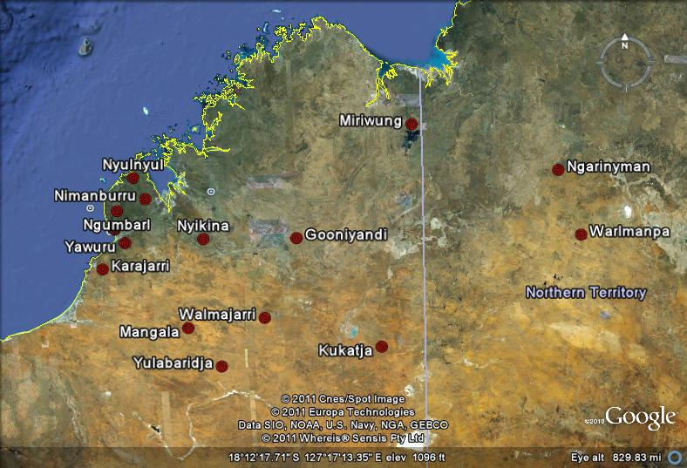
Loans into Proto-Nyulnyulan
*wi:ntuku ‘curlew’ < Ngumpin-Yapa
Wanderwort:
Ceremonial and
Mythological
significance

Slide 38
Other Kimberley Wanderwoerter
Karnanganyja ‘emu’
Kumpulangil ‘cockroach’
Cf also ‘shield’ calquing
Kuwaniya ‘freshwater crocodile’
Lumukul ‘blue-tongue lizard’
Mayarda ‘pelican’
Purntaru ‘quail’
Dumbu ‘owl’
Tyakuli ‘pearlshell’ (carved)
Tyintipirri ‘willy wagtail’
Tyibilyuku ‘duck’ (Bardi grebe)

Slide 39
Semantic Change

Slide 40
Semantic Change
Change of species
Karajarri linykurru ‘freshwater crocodile’ < (borrowed from) Yawuru linykurru ‘saltwater crocodile’
Bardi jiibily ‘grebe’ < WW tyipil ‘duck’
Metonymy/Metaphor
Nyikina kularrabulu turtle (generic) = “westerner”
Bardi anangarr ‘pumpkin-headed fish’ = Nyikina wanangarri ‘pebbles’
Walmajarri wamulu ‘wedge-tail eagle’ = Warlpiri ‘fluff, down’
Broadening/narrowing
Bardi goorlil = Chelonia mydas, also all turtles
Nimanburru jirrgabiny ‘frog (generic)’ = Bardi jarrgawiny ‘frog sp’

Slide 41
Semantic Change
Same processes as in other domains of vocabulary
But higher rates

Slide 42
Word Structure

Slide 43
Word structure tendencies

Slide 44
Word structure tendencies
Simplex terms very widespread;
Compounding absent in Nyulnyulan, more present in Pama-Nyungan (+ Yawuru);
Derivational terms in Nyulnyulan (+ Karajarri through calquing?)
=> Diagnostic for calquing of word structure?
=> Potential diagnostic for loan direction?

Slide 45
Conclusions

Slide 46
Not a ‘free for all’
Flora and fauna loan rates are higher than in basic vocabulary (unsurprising…)
But it’s not a free for all.

Slide 47
Place of generics
Generics can be securely reconstructed in many Kimberley families.
This and other evidence should lead us to reevaluating claims about universals in hunter-gatherer ethnobiological nomenclature systems

Slide 48
Word structure patterns
There is evidence for systematic patterns in individual families;
This can be exploited in reconstruction.

Slide 49
Areal patterns?
Some quite widespread patterns and Wanderwoerter:
*winduku
Others are much more local.
Flora/fauna provides evidence for population migration in Australia, just as elsewhere.

Slide 50
Further Directions

Slide 51
Acknowledgements
Research supported by NSF grants BCS-910936, BCS-902114 and BCS-844550
Australian Data Coding:
Barry Alpher, Patrick McConvell, Stef Spronck, Claire Bowern

